Slide 1

Client side validation
By Uchit Shrestha and Nishan Shrestha

Slide 2
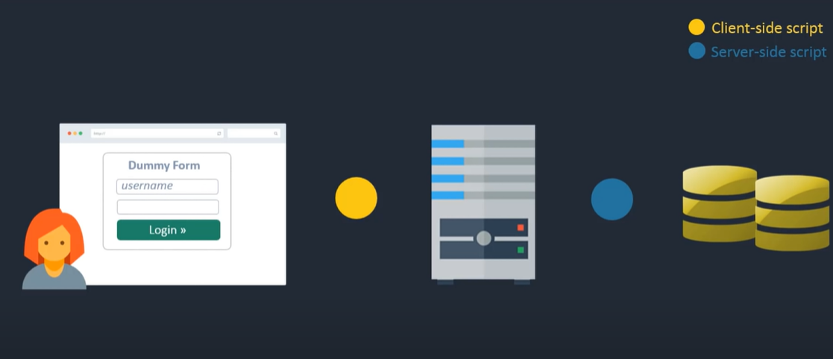
figure of client side and server side

Slide 3
Advantage of client side validation
Instant feedback : Client-side validation allows for immediate feedback to the user since it occurs in the user's browser without making a server request. This improves the user experience by reducing the waiting time.
Reduced server load: it reduces the workload on the server. The server doesn't have to spend time and resources on validating every single request because some errors are already caught and handled on the client side.
Improved responsiveness: With client-side validation, users can quickly correct errors before submitting the form, leading to a smoother and more responsive user interface.

Slide 4
Disadvantage of client-side validation
Reliance on JavaScript: Client-side validation heavily relies on JavaScript being enabled in the user's browser. If JavaScript is disabled or not supported, the validation will not work, leading to incomplete or invalid form submissions. This can negatively impact the user experience and result in data inconsistencies.
Security risks: client side validation can be easily bypassed by unauthorized users , who can manipulate the java script code or submit data directly to the server without going through the validation process .

Slide 5
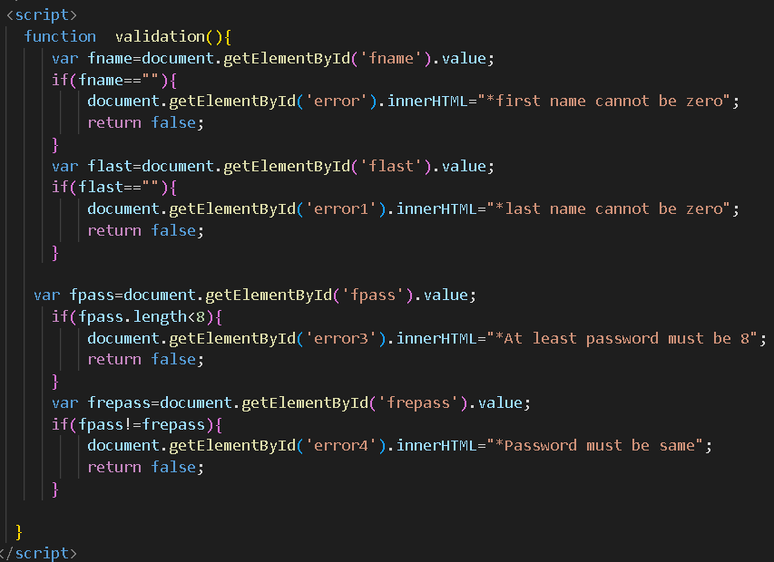

Slide 6
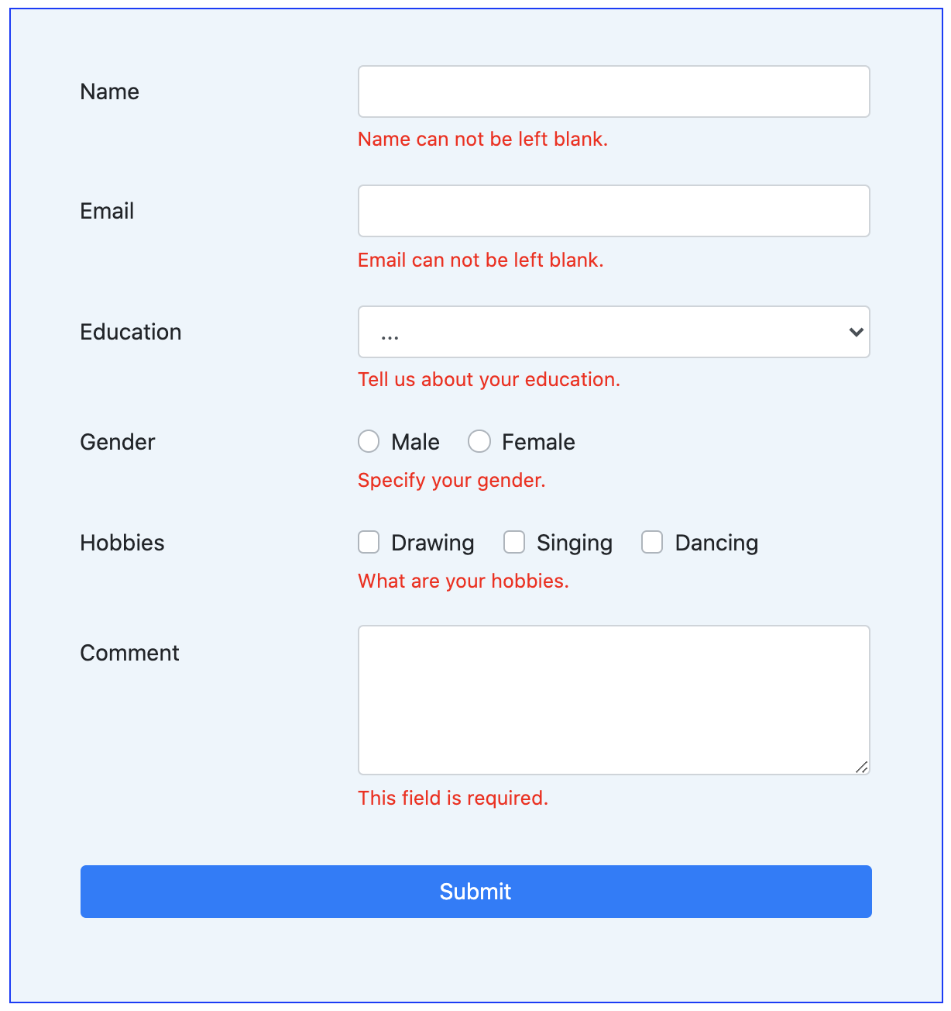
What is form validation?
Go to any popular site with a registration form, and you will notice that they provide feedback when you don't enter your data in the format they are expecting. You'll get messages such as:
"This field is required" (You can't leave this field blank).
"Please enter your phone number in the format xxx-xxxx" (A specific data format is required for it to be considered valid).
"Please enter a valid email address" (the data you entered is not in the right format).
"Your password needs to be between 8 and 30 characters long and contain one uppercase letter, one symbol, and a number." (A very specific data format is required for your data).

Slide 7
continue
This is called form validation. When you enter data, the browser or the web server will check to see that the data is in the correct format and within the constraints set by the application. Validation done in the browser is called client-side validation, while validation done in server is called server-side validation.

Slide 8
Thank you

